Slide 1
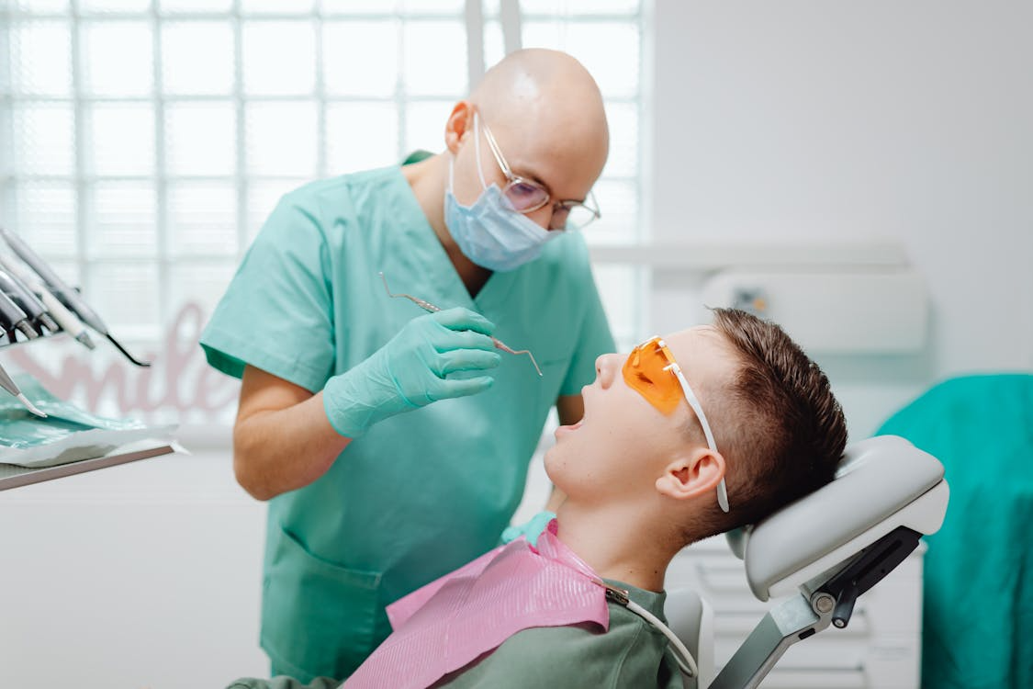
GOING TO THE DENTIST
A Social Story
Notes:
Pexels
https://www.pexels.com/photo/man-examining-a-persons-mouth-with-dental-tool-6627427/

Slide 2
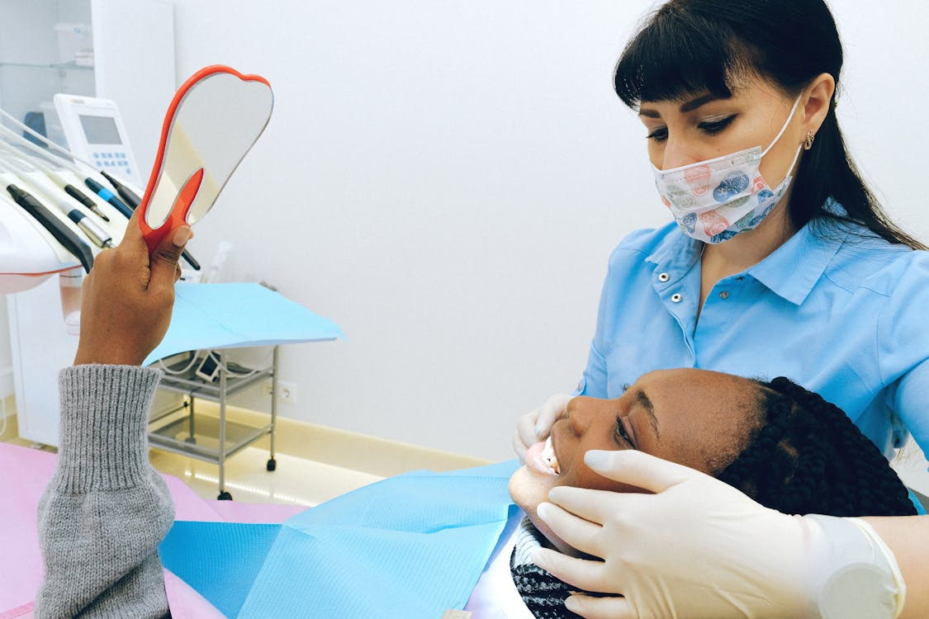
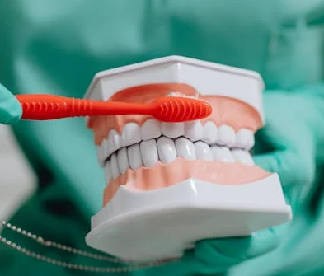
The Dentist is a teeth doctor.
They take care of my teeth.
Notes:
Pexels
1) https://www.pexels.com/photo/woman-having-dental-check-up-3845654/
2) https://www.pexels.com/photo/selective-focus-photo-of-a-dentist-demonstrating-how-to-brush-teeth-6627315/

Slide 3
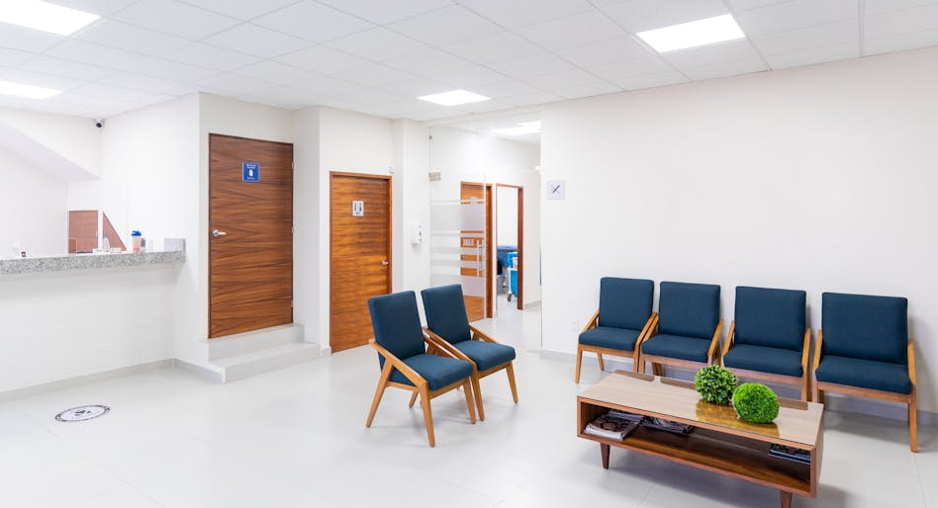
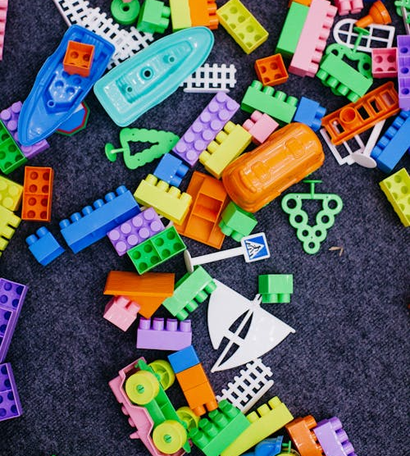
When I go to the dentist, I may need to wait for my turn in the waiting room or car.
I can play with toys, a tablet, or a book when I wait.
Notes:
Pexels
https://www.pexels.com/photo/waiting-room-in-a-hospital-8459996/
https://www.pexels.com/photo/close-up-of-toy-blocks-4491702/

Slide 4
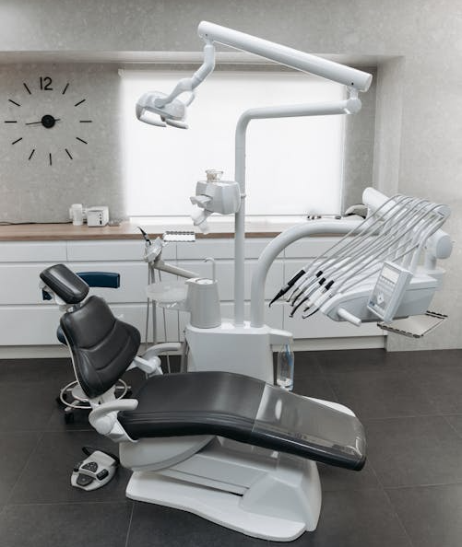
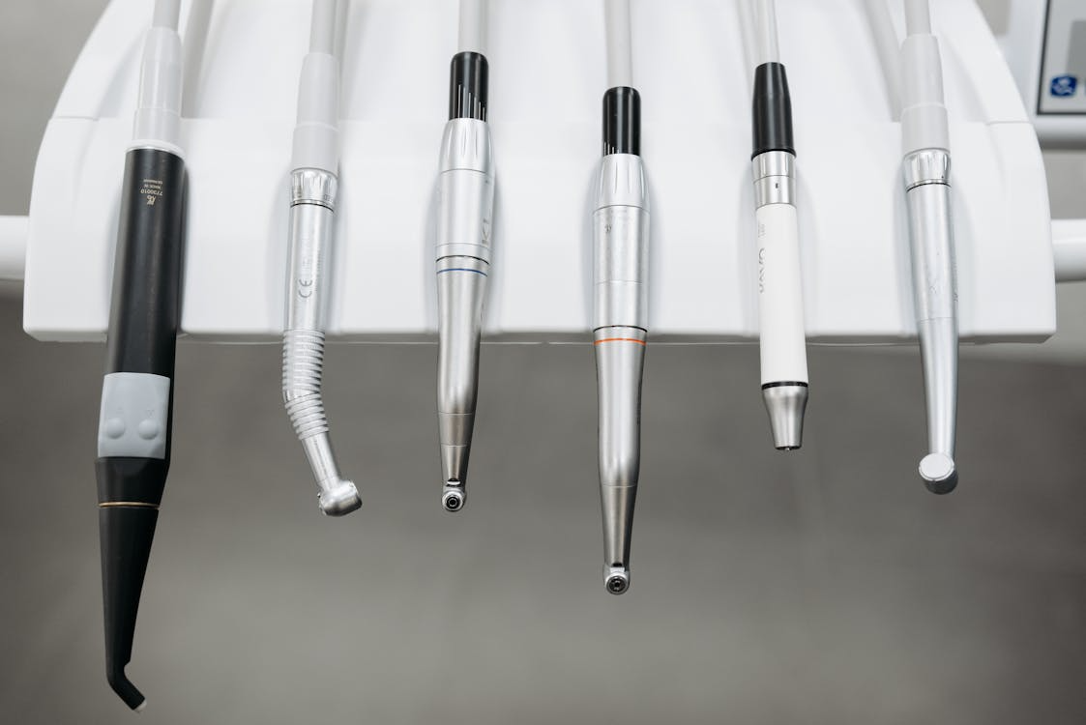
When it is my turn to see the dentist, I will go into a room with a special chair and dentist tools.
Notes:
Pexels
https://www.pexels.com/photo/dental-chair-and-equipment-in-a-clinic-6812480/
https://www.pexels.com/photo/a-close-up-of-dental-instruments-6812481/

Slide 5

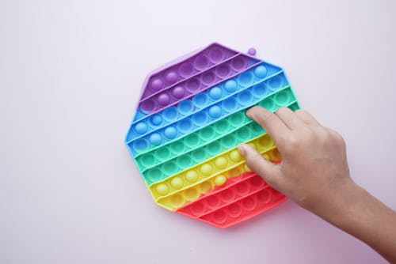
I can bring my favourite items from home to help me feel comfortable.
Notes:
Pexels
https://www.pexels.com/photo/closeup-photography-of-brown-teddy-bear-1019471/
https://www.pexels.com/photo/person-holding-blue-yellow-and-red-plastic-toy-11477550/

Slide 6
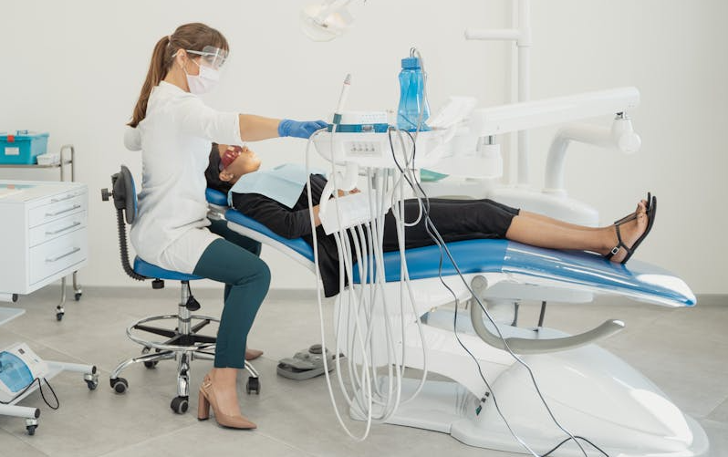
I will sit on the chair. The chair can move up, down, and lean back.
UP
DOWN
Notes:
Pexels:
https://www.pexels.com/photo/woman-in-black-blazer-sitting-on-dental-chair-5355825/

Slide 7
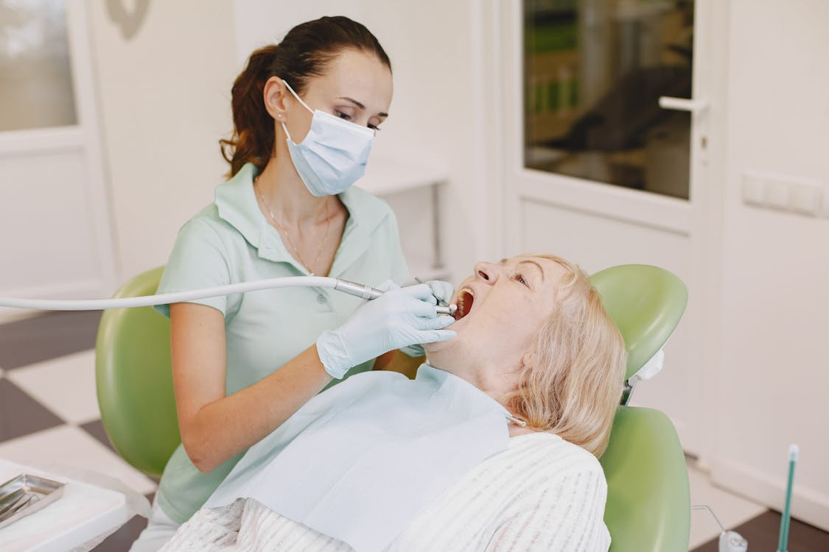
The dentist wears a mask and gloves when they check my teeth.
Notes:
Pexels:
https://www.pexels.com/photo/a-dentist-checking-on-patient-s-teeth-5621997/

Slide 8
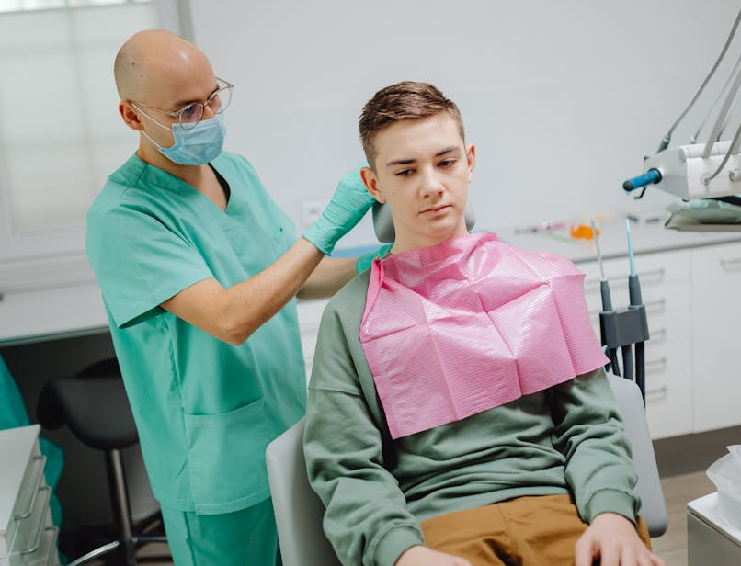
The dentist will put a bib on me to keep my shirt clean.
Notes:
Pexels:
https://www.pexels.com/photo/a-boy-in-long-sleeves-sitting-on-a-dental-chair-6627383/

Slide 9
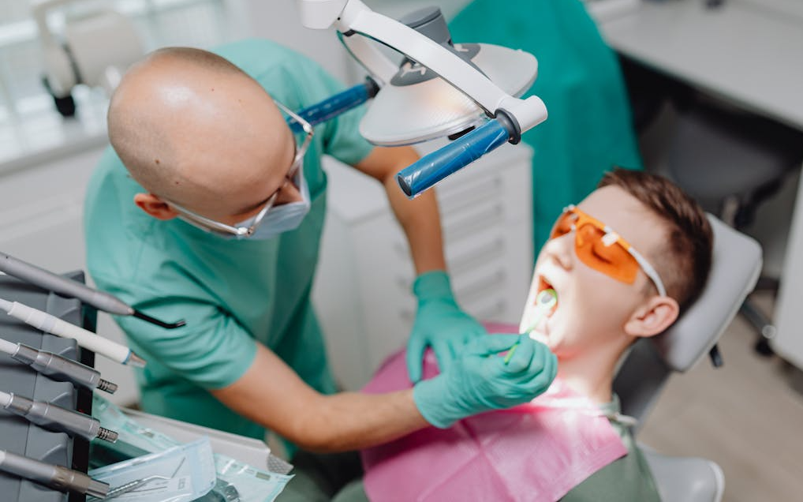
The dentist will turn on a bright light so they can see all my teeth.
If I want to, I can wear sunglasses to protect my eyes from the light.
Notes:
Pexels:
https://www.pexels.com/photo/dentist-curing-patient-teeth-6627453/

Slide 10
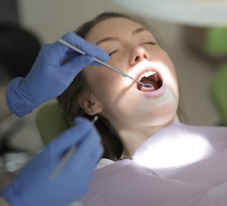
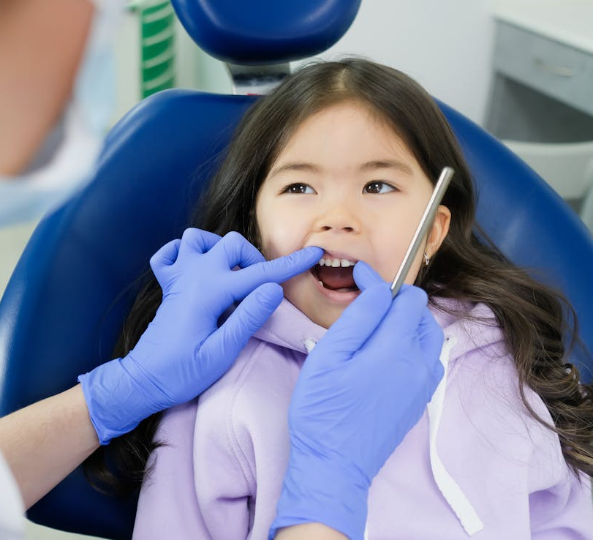
I will open my mouth really big and hold it open so the dentist can see all my teeth.
Notes:
Pexels
1) https://www.pexels.com/photo/unrecognizable-crop-dentist-in-latex-gloves-examining-teeth-of-patient-in-clinic-3881451/
2) https://www.pexels.com/photo/dentist-checking-teeth-of-patient-7800657/

Slide 11
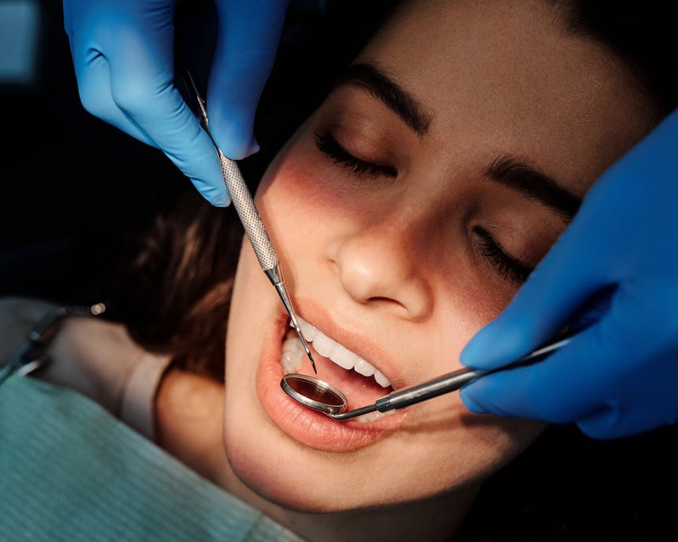
The dentist will use some silver tools to see and count all my teeth.
Notes:
Pexels:
https://www.pexels.com/photo/a-woman-having-a-dental-check-up-4269683/

Slide 12
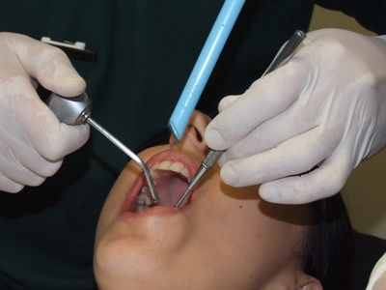
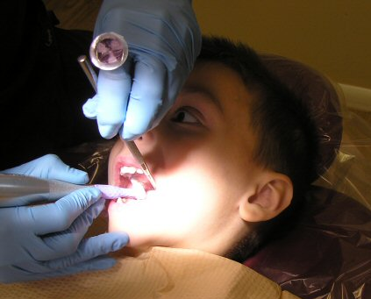
The dentist might use a toothbrush and some water to touch and clean my teeth.
Notes:
Pexels:
https://www.pexels.com/video/close-up-of-a-patient-being-examined-by-a-dentist-6502320/

Slide 13
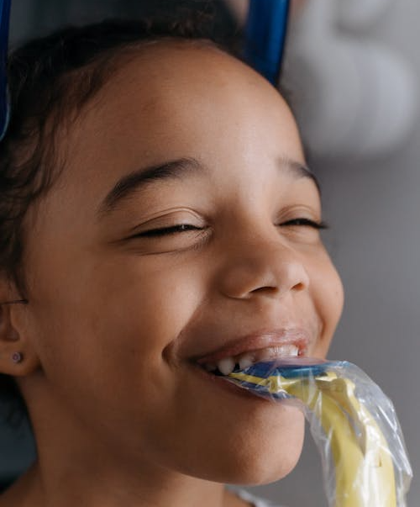
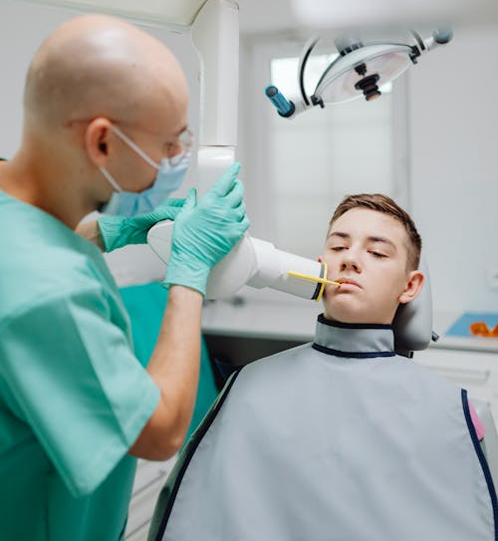
Sometimes the dentist might take special pictures of my teeth called X-rays.
This is how you take an
x-ray
They will ask me to bite down on some plastic and wear a heavy blanket.
Notes:
Pexels
1) https://www.pexels.com/photo/close-up-shot-of-a-girl-having-a-dental-checkup-6501922/
2) https://www.pexels.com/photo/a-medical-professional-using-a-dental-equipment-on-a-patient-6627478/

Slide 14
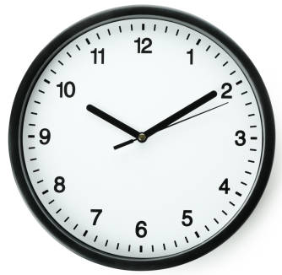

If I feel uncomfortable, I can ask for a break or to stop.
Notes:
Canva

Slide 15
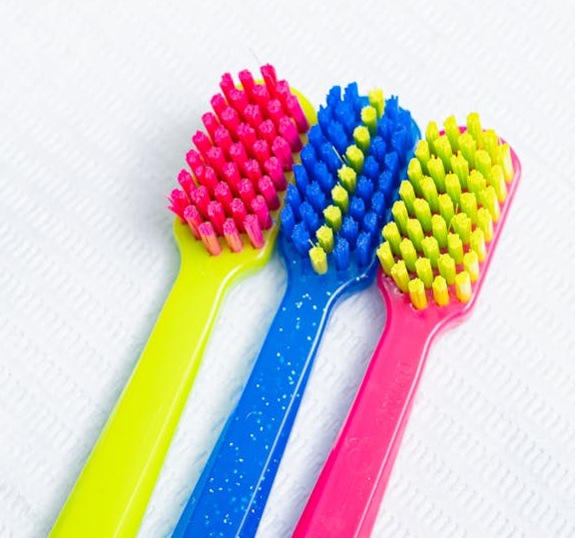

When I am finished the dentist might give me a new toothbrush and a special toy prize.
Notes:
Pexels
1) https://www.pexels.com/photo/close-up-of-colorful-toothbrushes-19147368/
2) https://www.pexels.com/photo/girl-in-purple-hoodie-sitting-on-blue-chair-7800561/

Slide 16
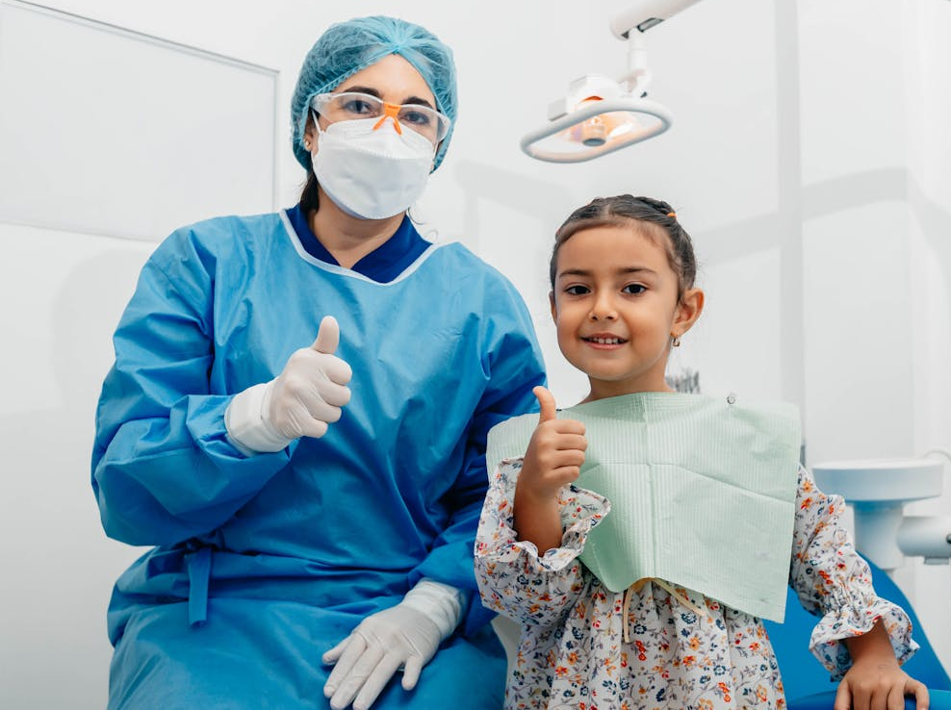
Everyone will be so proud of me for going to the dentist!
Notes:
Pexels:
https://www.pexels.com/photo/dentist-and-her-patient-posing-at-the-camera-12917374/

Slide 17
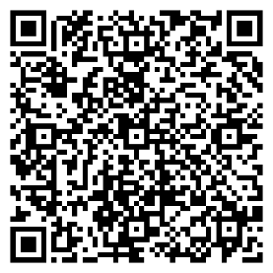
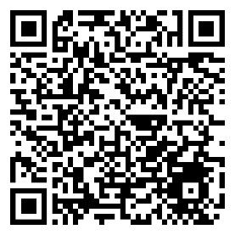


To learn more about dental visits, check out these resources.
To visit, click or scan the QR codes.
Going to the Dentist: A Toolkit to Support Dental Visits and Dental Practitioners
Supporting Dental Visits and Oral Hygiene Webinar
Photo credit: Canva.com

